Slide 1

Nous Proposal for Development of Python Library
Presented
To
DoctorCare
Leveraging 22+ years of expertise in global software services

Slide 2




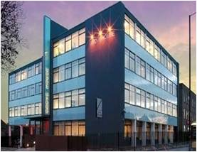

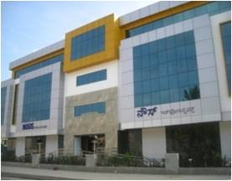
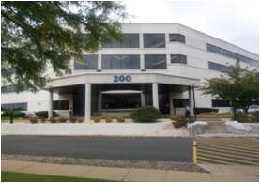
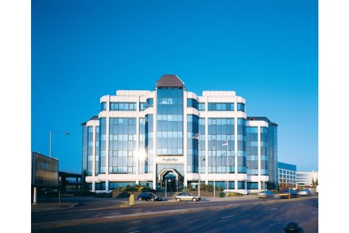
Corporate Profile
Technology Consultants help our clients to innovate
22+
Years of experience
1000+
Skilled workforce
Onshore/Offshore Model
90%
Repeat Business worldwide & 8.5 Avg. CSAT
Established process credentials
CMMi Level 5 v1.3
-ISO 9001:2015
-ISO/IEC 27001:2013
Global Service Offering
GSS
Testree
vServe
FULL LIFECYCLE
PES / ADMS SERVICES
INDEPENDENT
SOFTWARE TESTING & QA
REMOTE INFRASTRUCTURE MANAGED SUPPORT SERVICES

Slide 3
Our Understanding
About DoctorCare
DoctorCare is a group of clinicians and business professionals dedicated to improving healthcare in Ontario.
The only provider focused exclusively on helping Primary Care Physicians enhance patient care, run better businesses – and improve their own quality of life.
Problem statement / Inputs received
DoctorCare’s Practice Care Product is an analytic product that provides primary care practitioners with insights about opportunities to improve their medical practice and business. DoctorCare has developed technology product (Practice Care) that translates a set of data into actionable insights
DoctorCare is planning to replace the current web scraping solution that supports in downloading data from Ministry of Health website to PracticeCare Product
DoctorCare is looking to upgrade the solution by passing the Ministry of Health certification
The envisaged solution includes developing Python Library capable of connecting ministry of health MC EDT API and acquiring the Doctor Data from MC EDT Web Service

Slide 4
Scope
Scope
The scope of the project includes the following,
Development of Python Library (EDT) capable of passing Ministry of Health Certification tests
Create a Test Suite/App (EDT Test App) to validate the responses from SOAP requests
Support in conformance testing as required by Ministry of Health
Project Management of the engagement
Out of Scope
The following areas are currently considered out of scope for this project,
Integration of final python library into Practice Care product.
Conformance testing registration (DoctorCare to register and manage ministry of health registration needs).
Documentation
Any changes / integration with Practice Care App

Slide 5
High Level Activities
Week 1
Assess Existing System
Week 2-8
Week 9-10
Pilot user testing
Define acceptance criteria
Analyze system dependencies
Develop Python Library (EDT)
Fix issues raised in Verification
Sign off
Manual testing
Create a Test suite/App (EDT Test APP) to validate the data
Analyse the documents shared by ministry of Health

Slide 6


Current Process
Ministry of Health Website
Doctor Data
Practice Care App
Web Scraping

Slide 7
Proposed Solution
Ministry of Health Website
Doctor Data
SOAP Request
Python Library (EDT)
SOAP Response
EDT Test App

Slide 8
Key Milestones/Deliverables
Key Milestones / Deliverables
Python library API design completion
Python library passing internal conformance testing
Python library passing Ministry of Health conformance testing

Slide 9
Assumptions & Dependencies
Assumptions
DoctorCare will provide relevant SME’s/ product owner for getting information on the existing landscape and environment
DoctorCare will provide necessary access to the required documents, applications, services and databases
DoctorCare to ensure availability of a point of contact for clarification of business critical scenario/processes
DoctorCare to ensure the availability of Technical and Functional team and other stream stakeholders for understanding the current process and technology landscape
The availability of the Ministry of Health Website during Working hours
Any collaboration required with Ministry of Health will be performed by DoctorCare
Any changes to the scope and delays to the responses beyond 2 (two) days will impact the timeline and cost
The EDT test App developed will be a console application that can be leveraged for Testing activities
Any support required beyond the project duration will be considered as Change Request
Nous will provide a warranty support for 15 days after project completion
SME for Sign off

Slide 10
Timeline
Weeks
Key Tasks/Milestones
System Understanding
Development
Testing
Verification & Acceptance
1 | 2 | 3 | 4 | 5 | 6 | 7 | 8 | 9 | 10

Slide 11









Engagement Model
DoctorCare
Project Coordinator
DoctorCare Management Team
Nous’ Account Manager
Onsite (DoctorCare Office)
Communication (Email, Telephone)
Offshore (Nous Office)
Team Scale up
Resource
Performance Review
Substitutes
Availability
PM
Nous Human Resource Dept.
Resource Pool (on Demand)
Dev & Testing Team
Architect
QA
UI
BA

Slide 12
Escalation Model
The engagement will be governed by the following model
Level of Escalation | Nous Escalation Point | DoctorCare Escalation Point | Escalation Tracking
Level 1 | SBU Head | Mid Management | All escalations and incidents will be reviewed daily / weekly till closure
Level 2 | BU Head | Senior Management | All escalations need to be tracked till closure and reported in weekly review report
Level 3 | Executive | Executive Management | All escalations are informed every fortnight

Slide 13
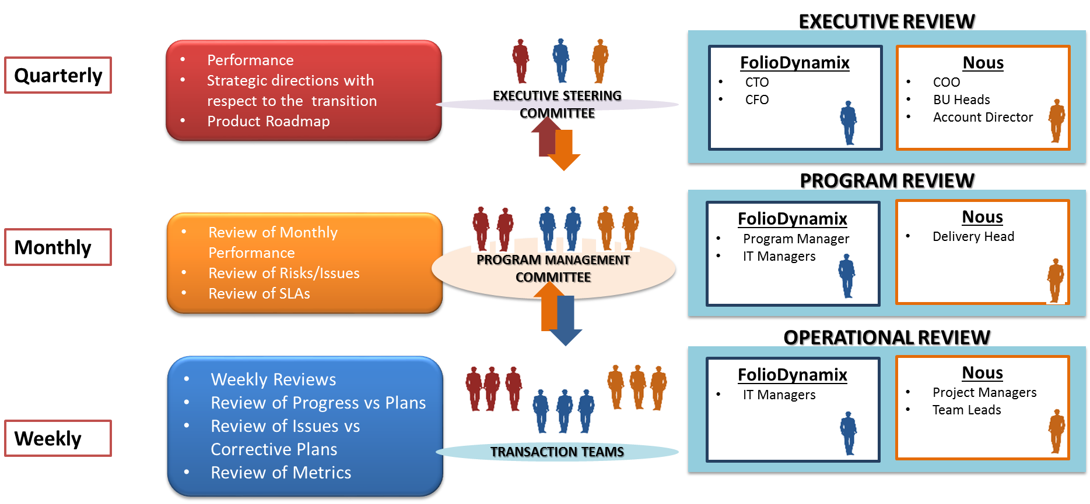
Governance Model
DoctorCare
Application Director
Business Unit Head
Application Director
DoctorCare
Delivery Manager
Technical Manager
DoctorCare
Project Manager
Project Manager

Slide 14
Commercials
Description | Price (USD)
Total cost for the engagement | 15180
Terms & Conditions:
The invoices for the said services will be raised from Nous, India as described in the payment and delivery schedule
Project will be executed in Fixed Price model
All rates are inclusive of taxes for invoices generated from India
Nous resources will work from Nous India offices, Bangalore
DoctorCare will pay Nous within 30 (Thirty) days from the date of receipt of a correct invoice submitted by Nous.
DoctorCare will be responsible for review and sign-off of all project deliverables within 5 business days after submission of the deliverables
All invoices will be deemed accepted, if no discrepancy reported in writing to Nous by DoctorCare within five (5) business days from the receipt of the invoice

Slide 15
Appendix – About Nous

Slide 16
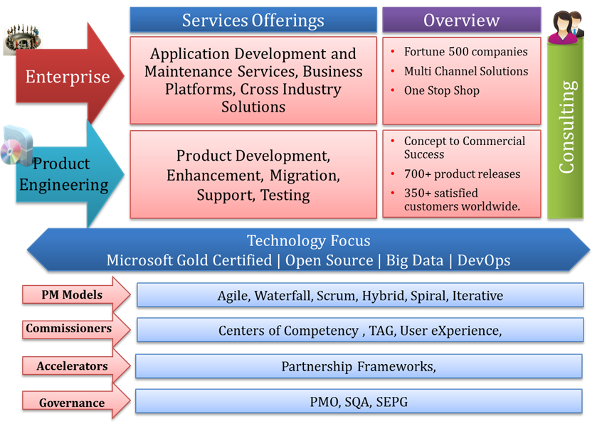
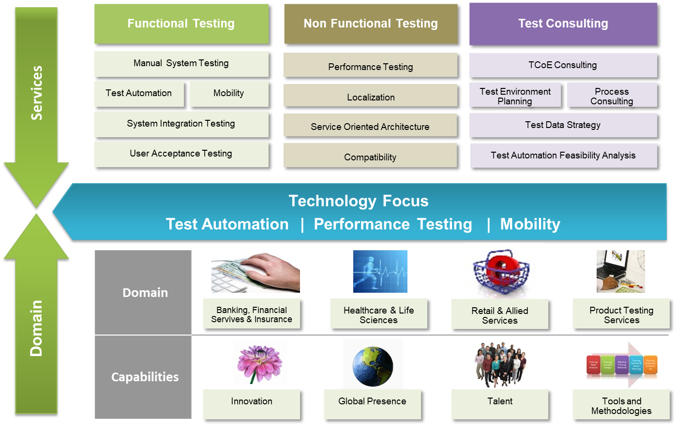
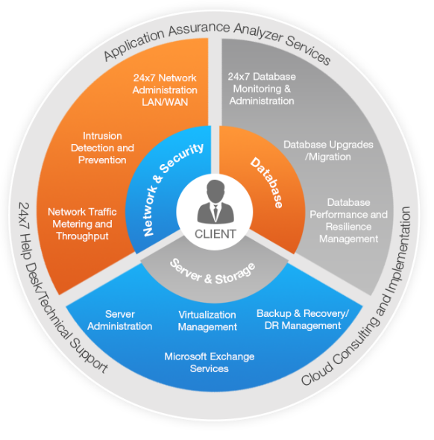
Independent SBU’s for Focused Service Delivery
GSS : The Global Software Services(GSS) division offers comprehensive end to end business solutions
Testree :Independent Verification and Validation (IVV) division of Nous Infosystems
vServe24/7: This Strategic Business Unit offers Infrastructure Management Services.

Slide 17
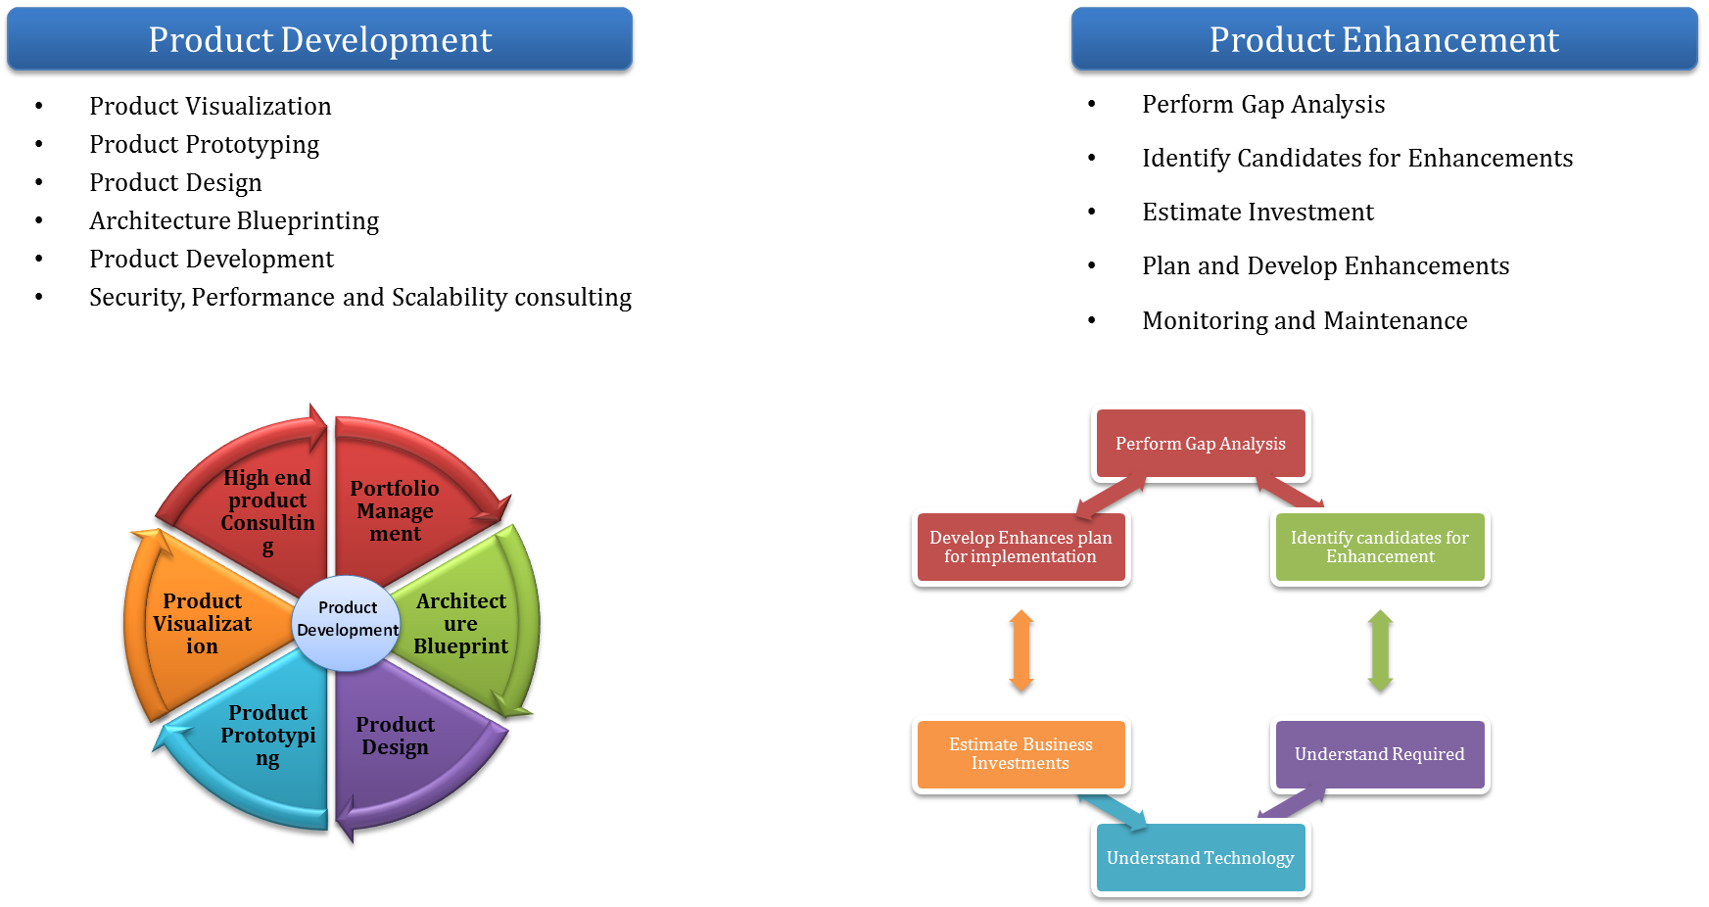
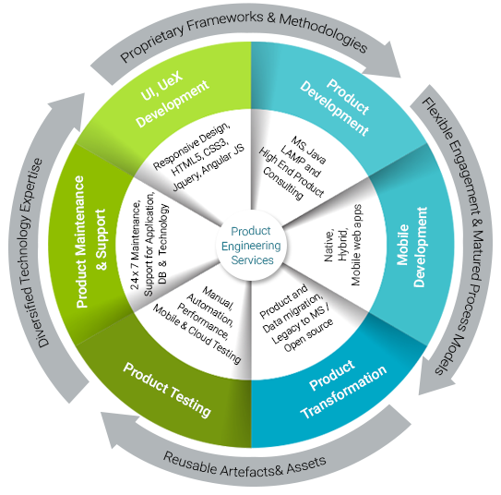
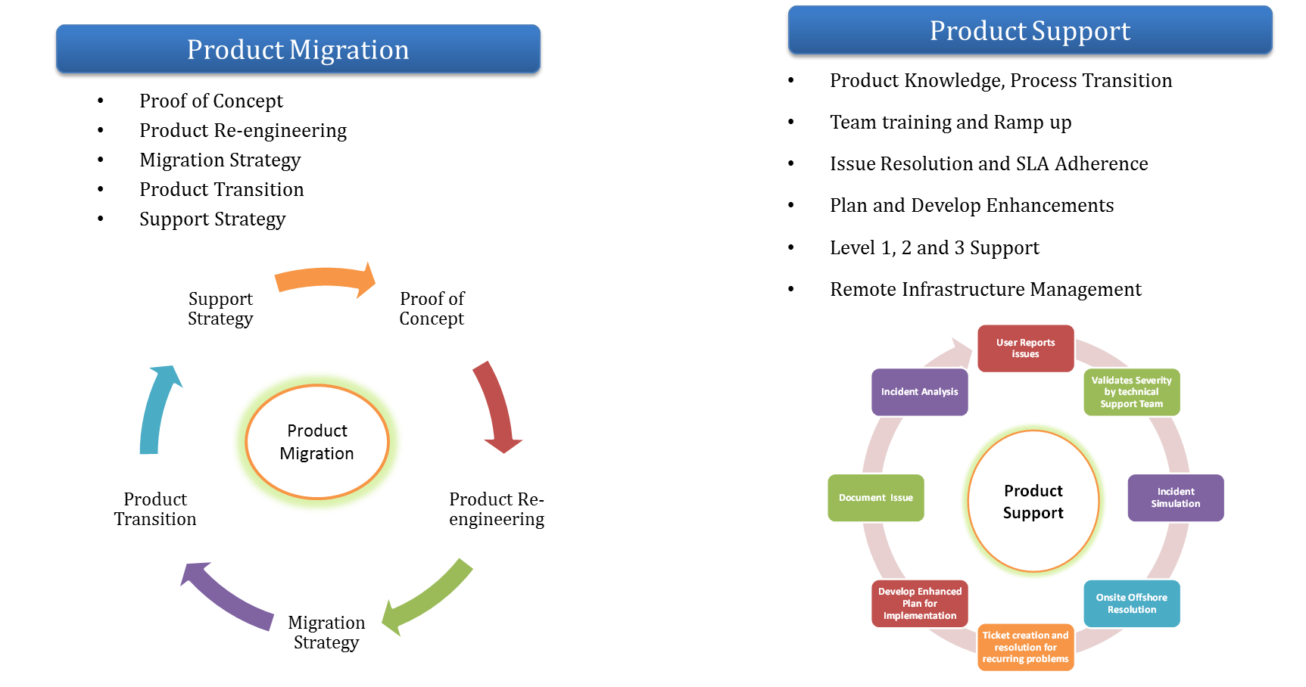
Product Engineering Services

Slide 18
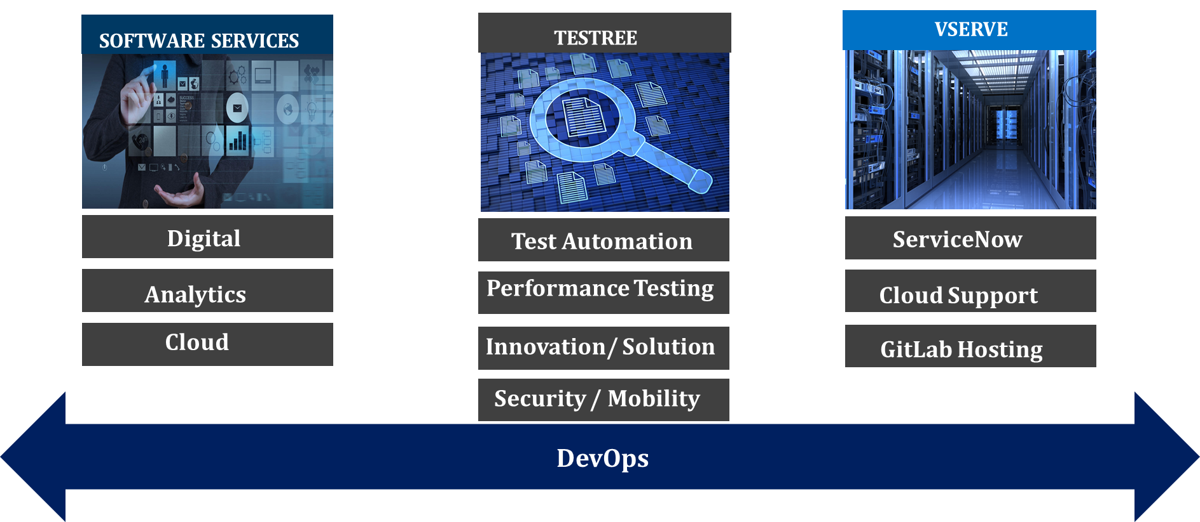
Nous CoEs

Slide 19


GSS CoEs
DIGITAL
ANALYTICS
Content Management
CRM
UI
UX
Mobility
BPM/Workflows/RPA
BI
DW
Big Data
Azure
AWS
CLOUD

Slide 20
NORTH AMERICA
New Jersey, USA
Tel: +1 732 985 9533
California, USA
Tel: +1 925 359 3232
Toronto, Canada
Tel: +1 905 402 9943
EUROPE
Brentford, UK
Tel: +44 208 587 1411
Mainz, Germany
Tel: +49 6131 28910 31
www.nousinfosystems.com www.testree.com www.vserve247.com info@nousinfo.com
ASIA
Bangalore, India
Tel: +91 80 41939400
Coimbatore, India
Tel: +91 422 4300300

